Slide 1

TOPIC 5:
AGILE SCRUM PROJECT MANAGEMENT (Part 1)
Prepared by Dr Jamilah Mahmood dan Dr Shahliza Abd Halim

Slide 3
Outline
Part 1:
Product Backlog
Spring Planning
Sprint Backlog
Sprint Increments
Note: The overall contents of the slide are based on the main reference that is Sommerville (2016) with other references specified directly in respective slides

Slide 4
Objectives
The objectives of this module are:
Explain the key concepts and principles of Agile Scrum Project Management.
Describe the purpose and structure of the Product Backlog, including how it is created, prioritized, and maintained.
Outline the process of Sprint Planning, including how the Sprint Goal is defined and PBIs are selected for the Sprint.
Differentiate between the Product Backlog and Sprint Backlog in terms of ownership, scope, and level of detail.
Construct and analyze a Sprint Backlog by breaking down selected user stories into detailed tasks.

Slide 5
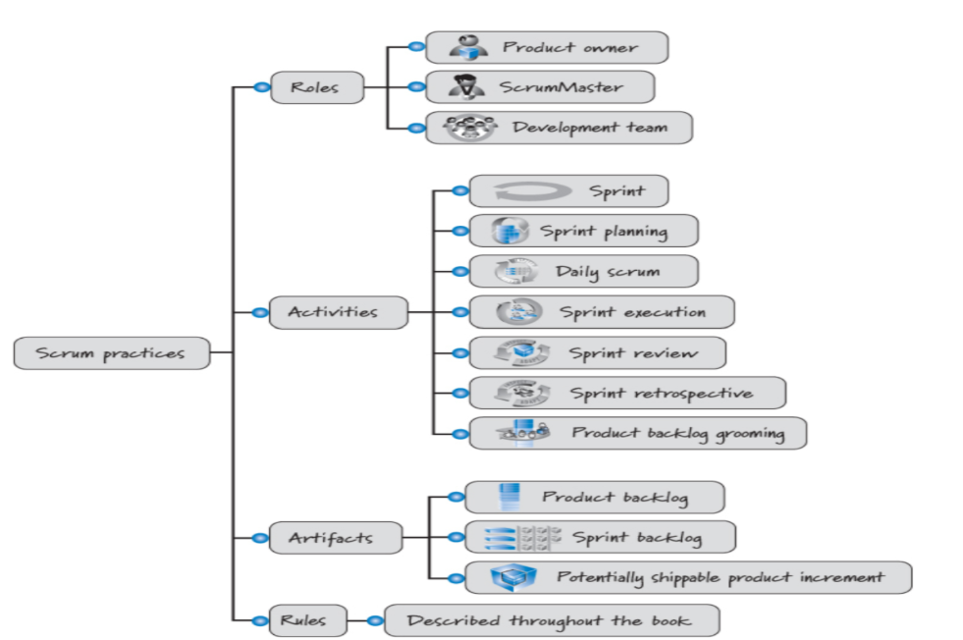
SCRUM Practices
Cohn, M. (2012). Essential Scrum: A practical guide to the most popular Agile process (Addison-Wesley Signature Series). Addison-Wesley.

Slide 6
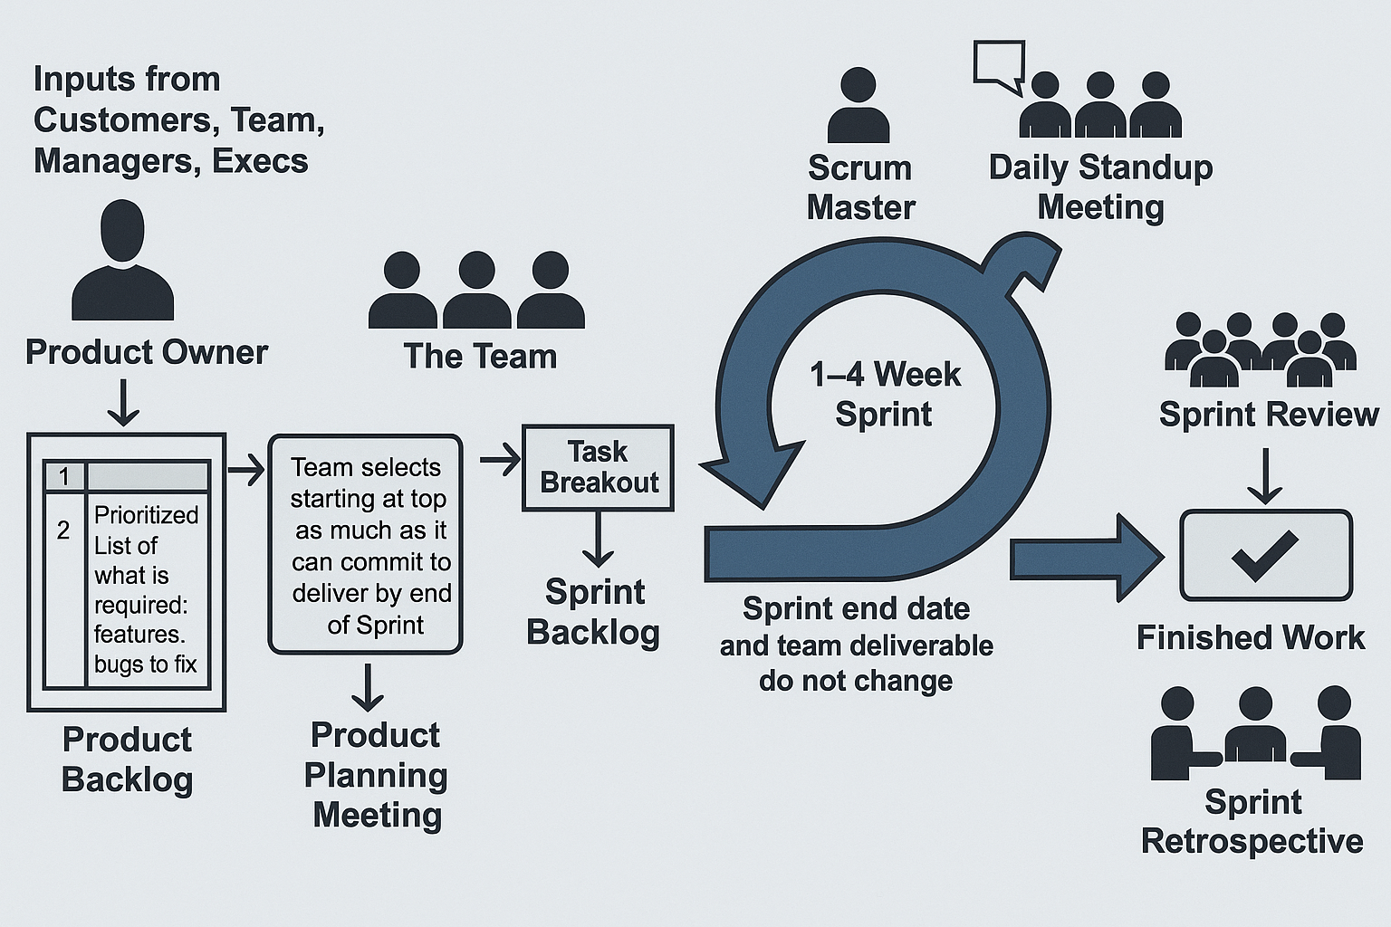
SCRUM Model Revisited
Scrum defines five key events
  Heart of the scrum is the Sprint, Daily Scrum, Sprint Review, and Sprint Retrospective.

Slide 7
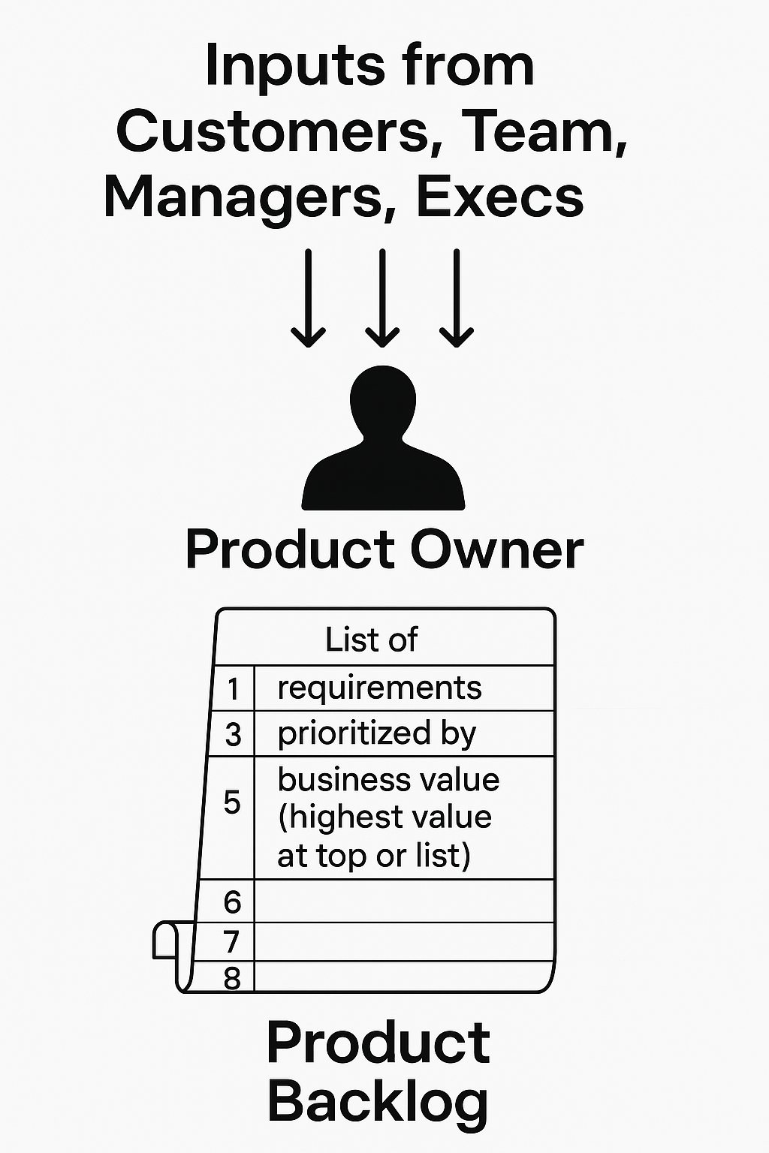
Product Backlog

Slide 8
Introduction to Product Backlog
It is a repository of Product Backlog Items (PBIs) which consists of Epics, User Stories and other work to be done.
It is a queue of the work to be done in the organized form of small increments of work, typically in the form of user stories.
It is the single source of requirements for any changes to be made to the product.
Maintained and owned by the Product Owner.

Slide 9
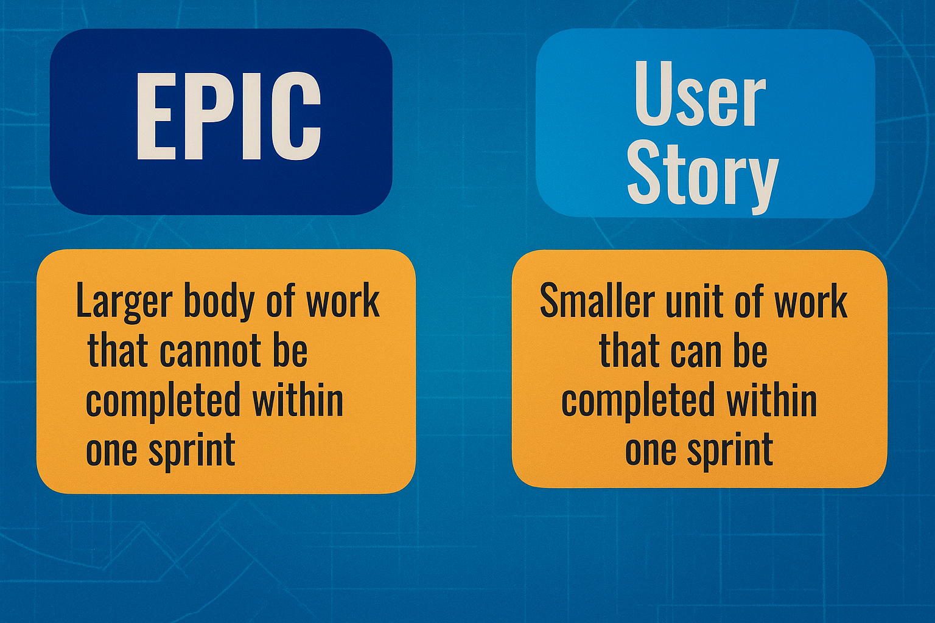
Epic and User Story

Slide 10
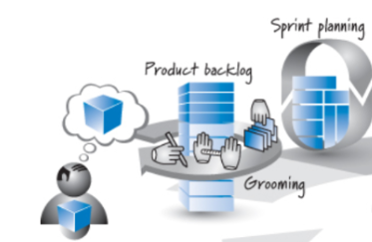
Product Backlog Grooming
A very important step in the Scrum process is Product Backlog Grooming which is also called “Product Backlog Refinement.” In Product Backlog Grooming (refinement), the team (or part of the team including the Product Owner) meets regularly to “groom the Product Backlog,” in a formal or informal meeting which can lead to any of the following:⁴
removing user stories that no longer appear relevant
creating new user stories in response to newly discovered needs
reassessing the relative priority of stories
assigning estimates to stories which have yet to receive one
correcting estimates in light of newly discovered information
splitting user stories that are high priority but too coarse-grained to fit in an upcoming iteration.

Slide 11
Example: Epic
Epic 1: Build Basic Website Interface
As a customer, I want to browse the pizza menu online so that I can easily view available options before placing an order.
Epic 2: Implement Online Payment System
As a customer, I want to pay for my order online so that I don’t have to use cash or handle money during delivery.
Epic 3: Enable Custom Pizza Creation
As a customer, I want to create my own pizza by selecting ingredients, so that I can personalize my order to my preference.

Slide 12
Components of Product Backlog Items (PBIs)
Each item in the backlog typically includes:
Title or ID
User Story / Description (e.g., "As a user, I want...")
Priority / Ranking
Estimation (e.g., story points)
Example Product Backlog Items for Pizza Online Order
Epic | ID | User Story | Priority | Estimation
As a customer, I want to browse the pizza menu online so that I can easily view available options before placing an order. | USI01 | As a customer, I want to view a pizza menu with images and prices. | High | 5 SP
 | USI02 | As a customer, I want to add pizzas to a cart and review my order. | High | 8 SP

Slide 13
Sprint Planning

Slide 14
Sprint Planning
Sprint planning meeting takes prior to the beginning of every sprint
Two major goals:
  Product owner and the team negotiate what stories will be taken into sprint (based on priority ranking, level of effort for each story and estimated team capacity or velocity)
    Select high-priority Product Backlog Items (PBIs) for the sprint.
    Break down PBIs into technical tasks.
  Team to define the tasks that will be needed to implement those stories and also to plan the the tasks allocation.

Slide 15
Sprint Backlog

Slide 16
Sprint Backlog
A Sprint Backlog is a subset of the Product Backlog selected for a specific Sprint.
It includes all Product Backlog Items (PBIs) committed to during Sprint Planning.
Contains detailed tasks the team will carry out to deliver the selected increment.
Owned and managed by the Development Team.

Slide 17
Example – Sprint Backlog for Pizza Online Order System
Sprint Goal: Enable basic pizza ordering functionality
Sprint Backlog (task breakout)
US101:
  Design menu UI
  Develop pizza menu item selection logic
  Unit testing and validation
US102:
  Build shopping cart
  Order summary module
  Unit testing and validation
ID | User Story | Priority
USI01 | As a customer, I want to view a pizza menu with images and prices. | High
US102 | As a customer, I want to add pizzas to a cart and review my order. | High
PBIs:
USI01: Browse pizza menu
USI02: Order cart functionality

Slide 18
Product Backlog vs Sprint Backlog
Aspect | Product Backlog | Sprint Backlog
Ownership | Product Owner | Development Team
Scope | Entire product | Items for one sprint
Detail | Varies (depends on priority) | Highly detailed
Flexibility | Continuously evolving | Fixed during sprint

Slide 19
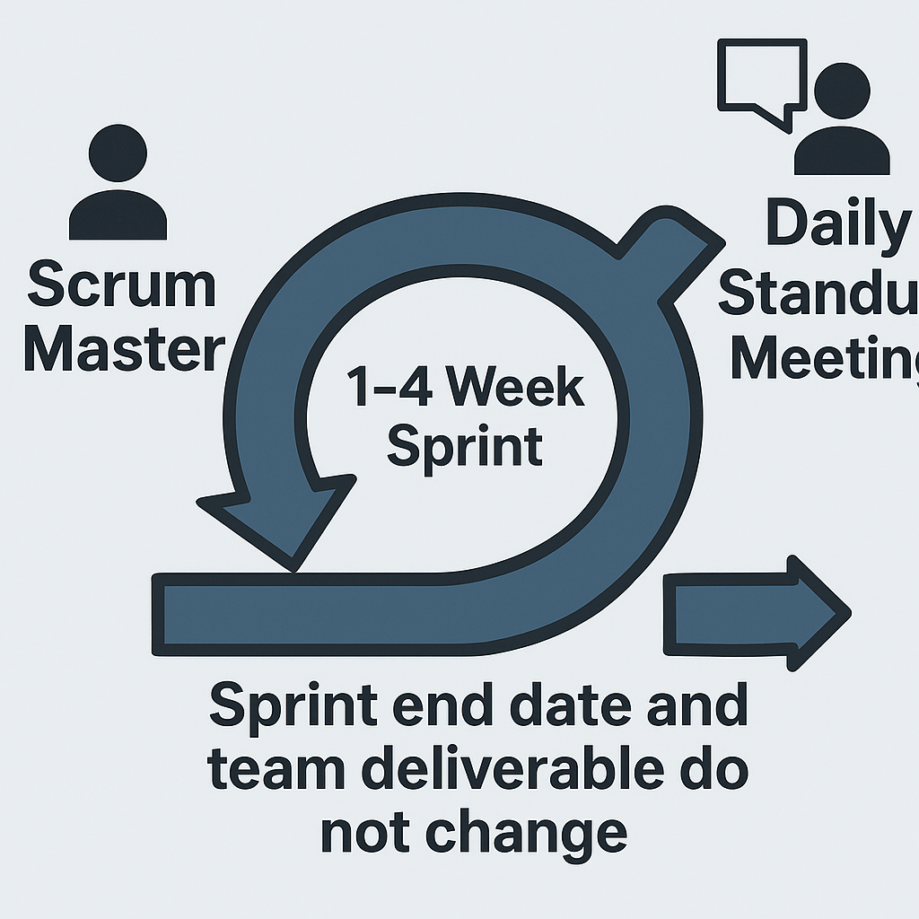
Sprint Increments

Slide 20
Sprint Increments
Minimum Viable Product (MVP)
A version of a product with the minimum features needed to deliver value to users and gather feedback.
Used to validate product assumptions early and minimize unnecessary development.
Identified from the Product Backlog based on business value and user needs.
Planned during Sprint Planning and delivered in early sprints.
Reviewed and improved based on Sprint Reviews and Retrospectives.

Slide 21
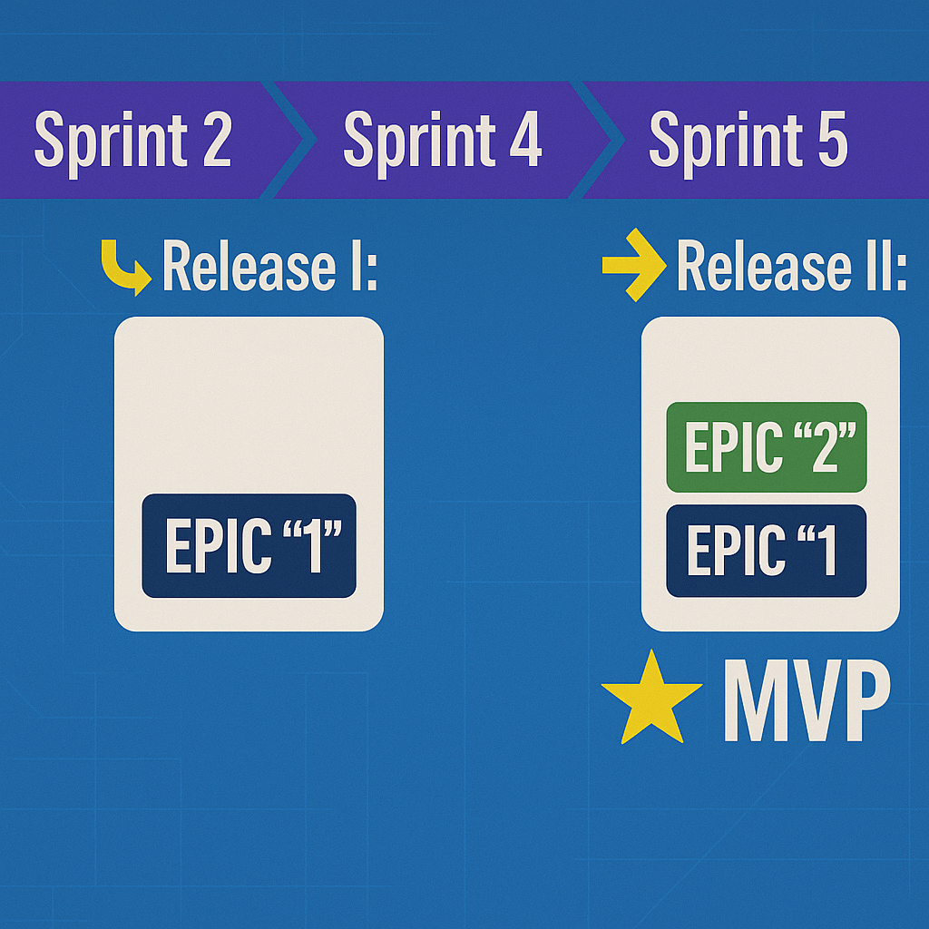
Sprint, Release, and MVP
The core functionalities are developed first, allowing users to begin using and testing the product in real-world conditions.

Slide 22
Example of Minimum Viable Product (MVP)
Epic 1: Build Basic Website Interface
Epic 2: Implement Online Payment functionality
Epic 3: Enable Custom Pizza Creation
Not Critical for the website to start working
SPRINT 1
SPRINT 2
SPRINT 3
SPRINT 4
SPRINT 5
SPRINT 6
Release 1
Release 2
Release 3
MVP Consideration:
What are the functionalities, without which the
Pizza restaurant cannot start offering deliveries and introduce its new service to the market?
EPIC 1
EPIC 2
EPIC 1
EPIC 3
EPIC 2
EPIC 1

Slide 23
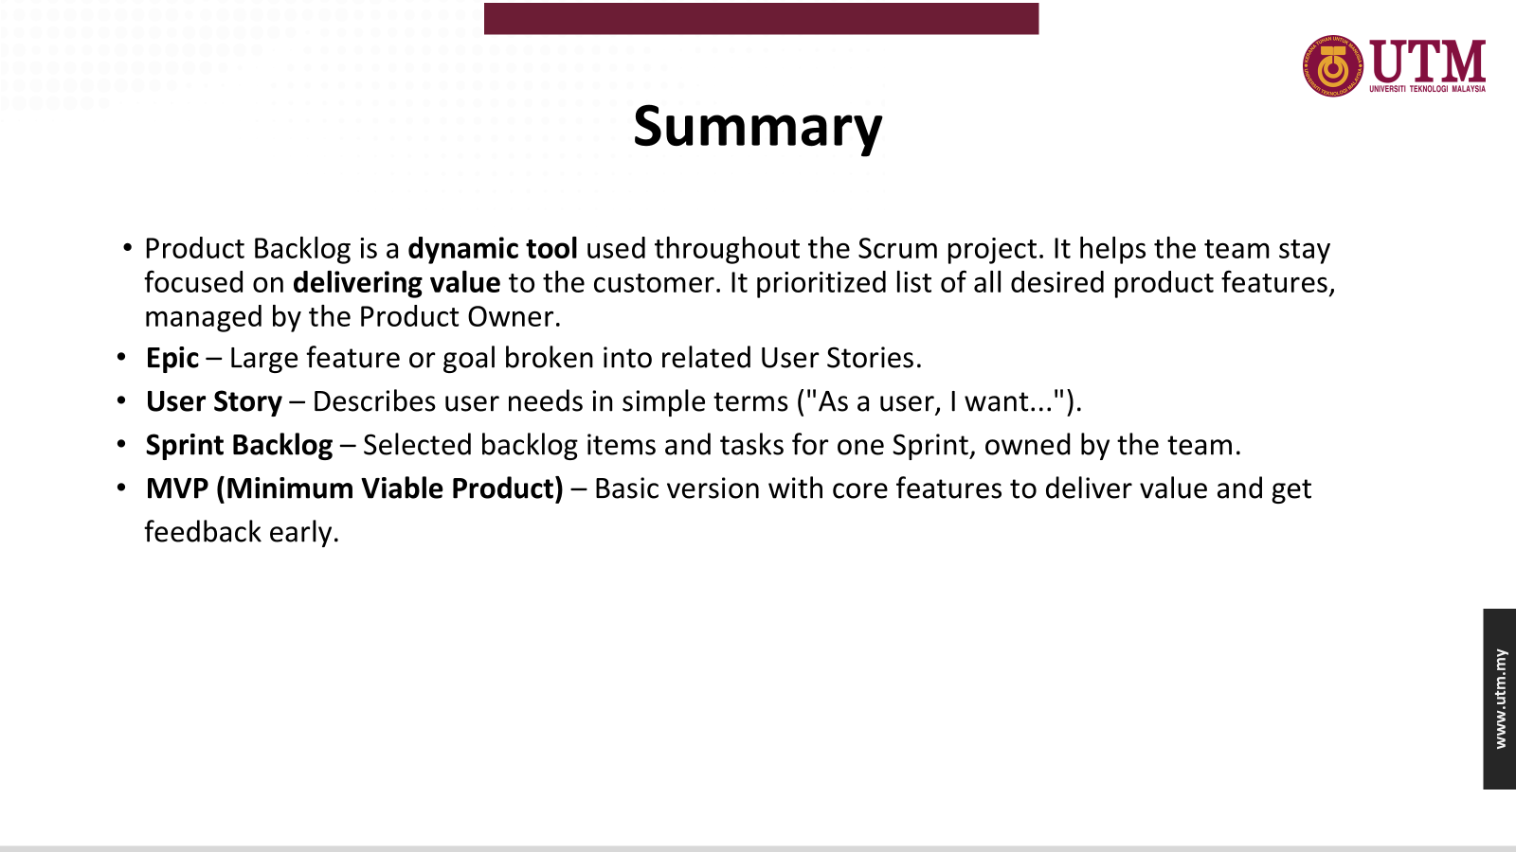

Slide 24
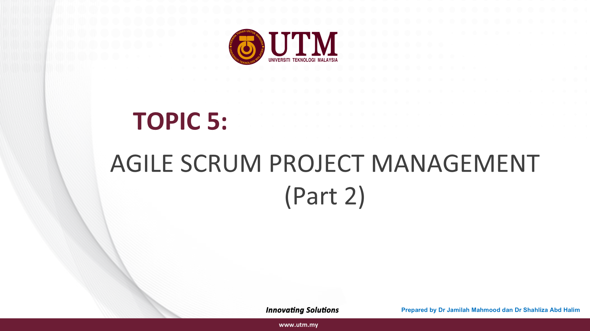
Summary
Product Backlog is a dynamic tool used throughout the Scrum project. It helps the team stay focused on delivering value to the customer. It prioritized list of all desired product features, managed by the Product Owner.
Epic – Large feature or goal broken into related User Stories.
User Story – Describes user needs in simple terms ("As a user, I want...").
Sprint Backlog – Selected backlog items and tasks for one Sprint, owned by the team.
MVP (Minimum Viable Product) – Basic version with core features to deliver value and get feedback early.

Slide 25
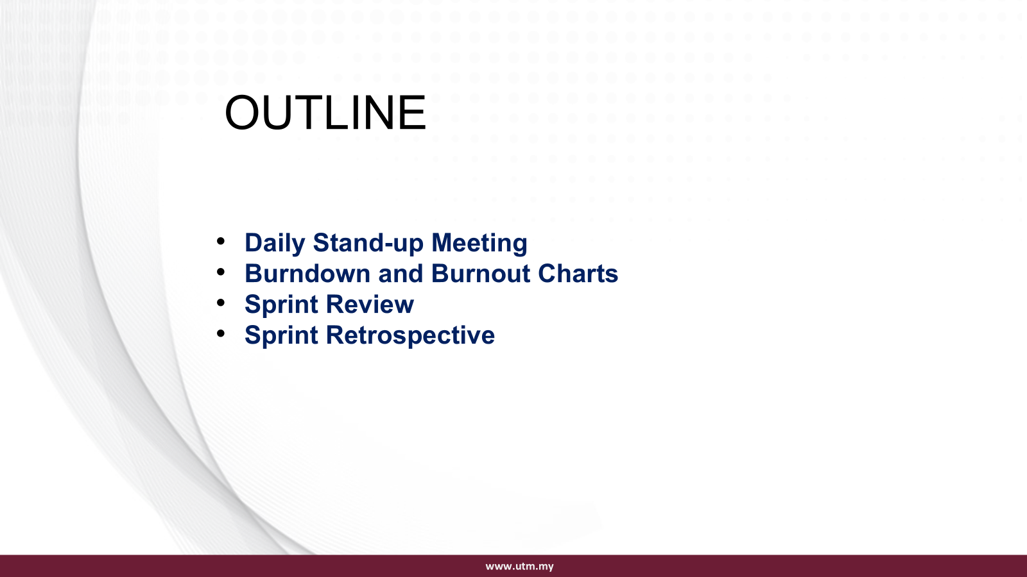

Slide 26
DAILY SCRUM / STAND-UP MEETING
What it is: A 15-minute time-boxed meeting held every day of the sprint.
Participants: The Development Team (Scrum Master facilitates but does not lead).
Purpose: To synchronize activities and create a plan for the next 24 hours.
Each team member answers:
  What did I do yesterday?
  What will I do today?
  Are there any problem in my way?
Key Benefit:Promotes team transparency, accountability, and early problem detection

Slide 27
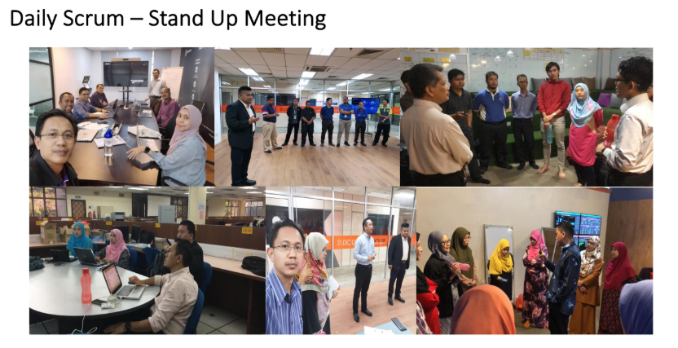
UTMSMART Project

Slide 28
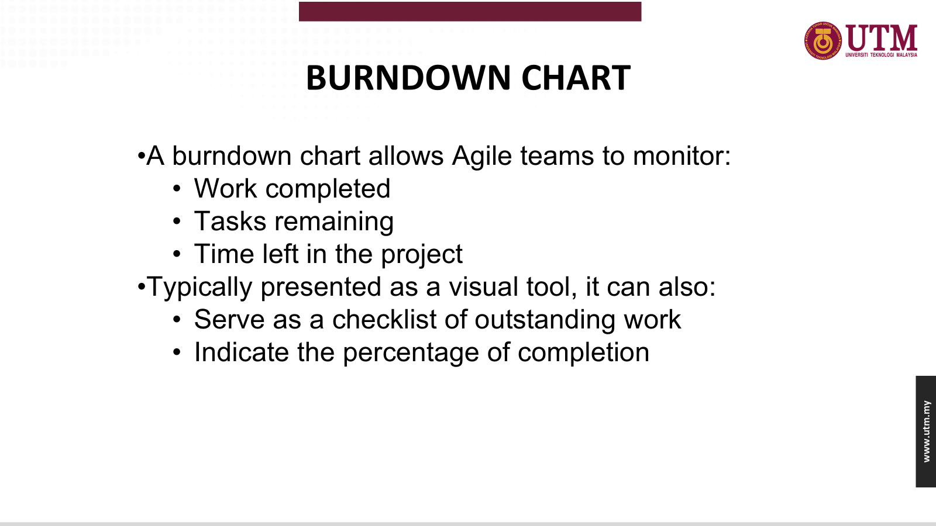

Slide 29
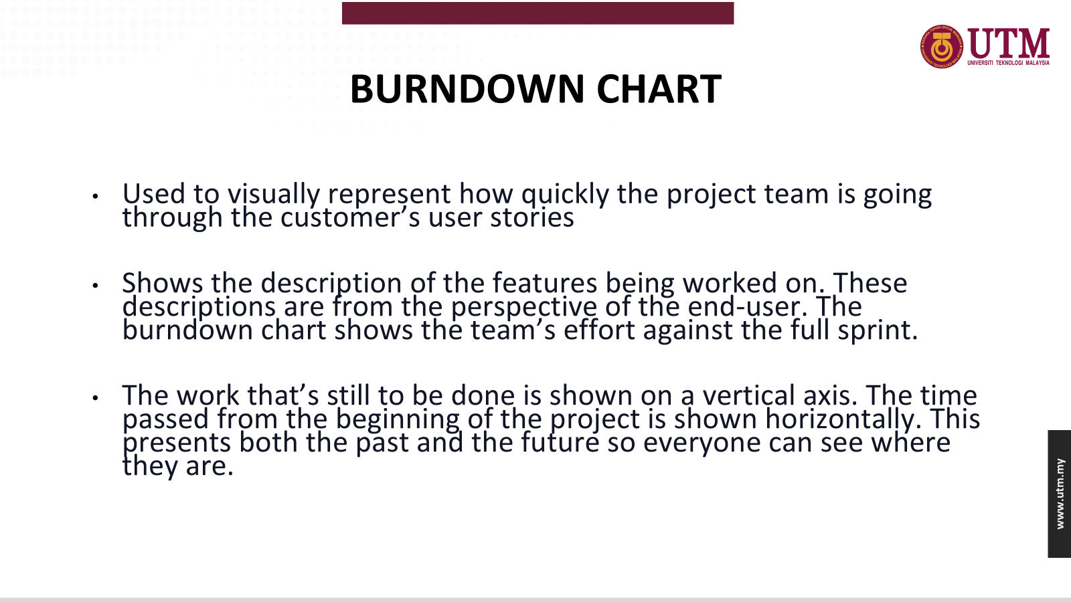

Slide 30
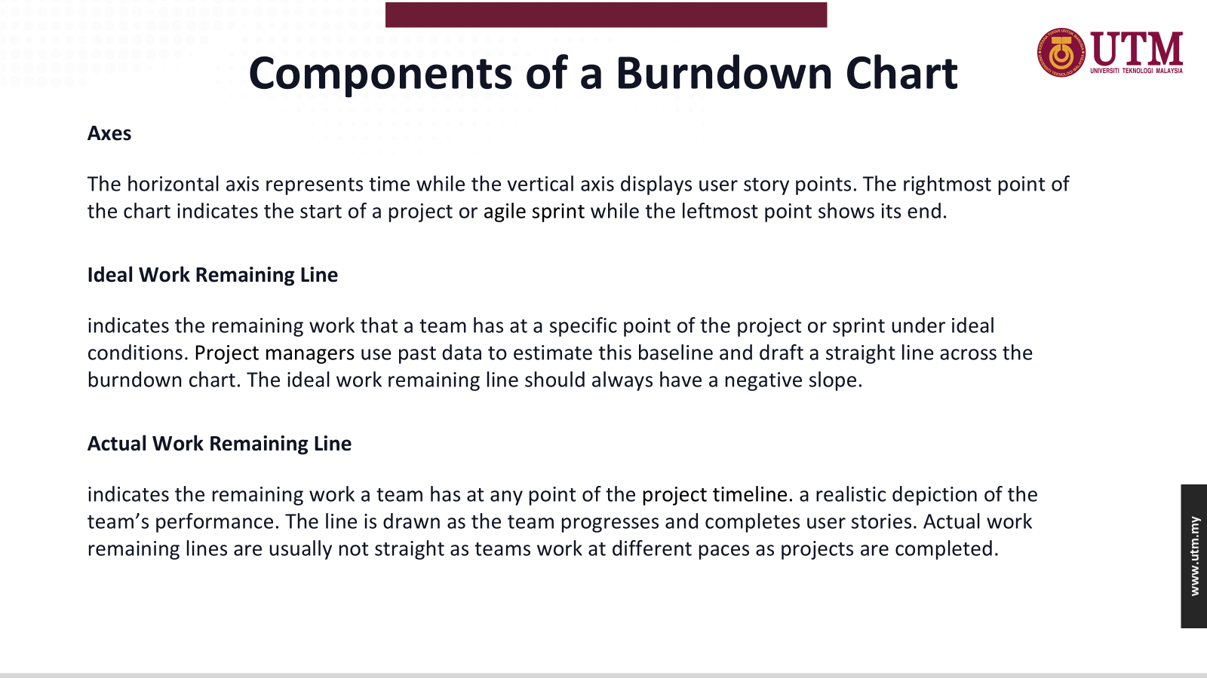

Slide 31
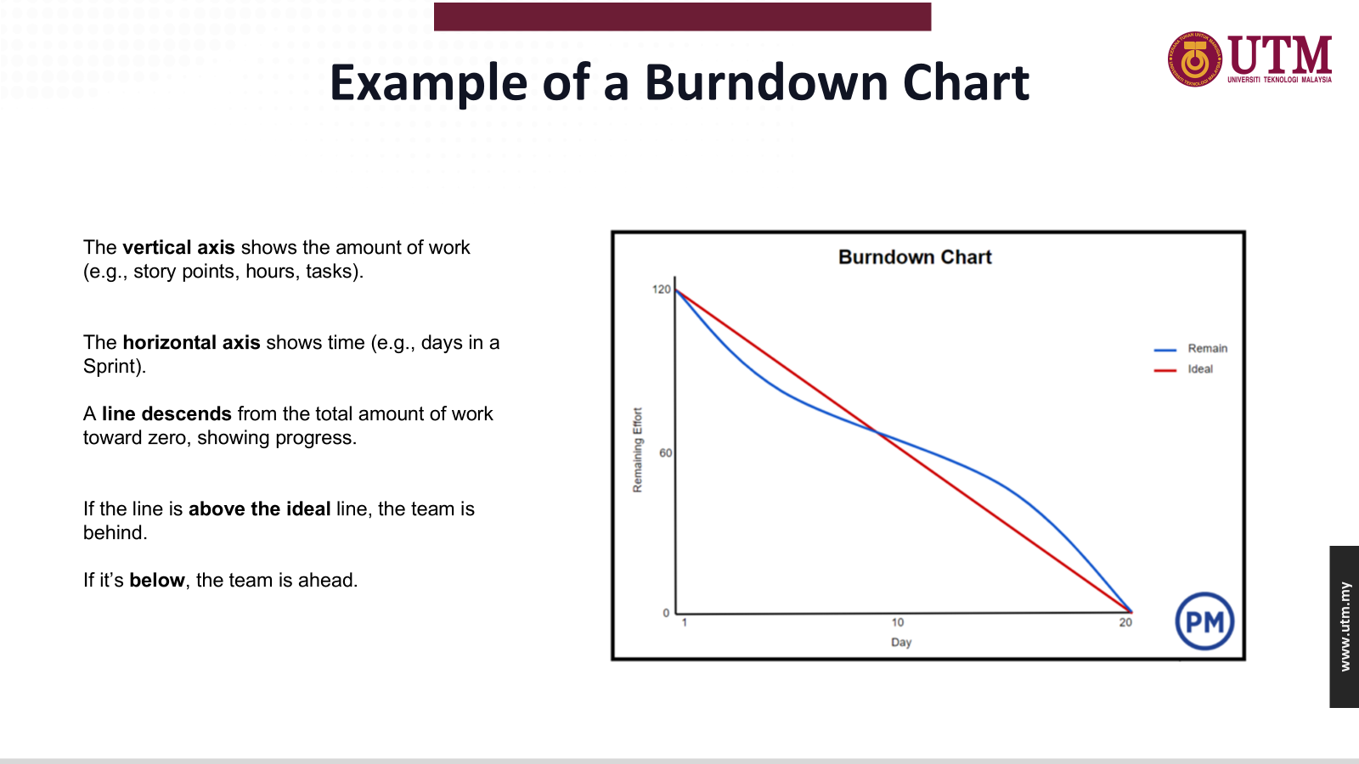

Slide 32
BURNUP CHART
A visual tool for project managers and their teams to see how much work has been done and how much work is left.
Used for tracking work in a project schedule or during a sprint in a scrum.

Slide 33
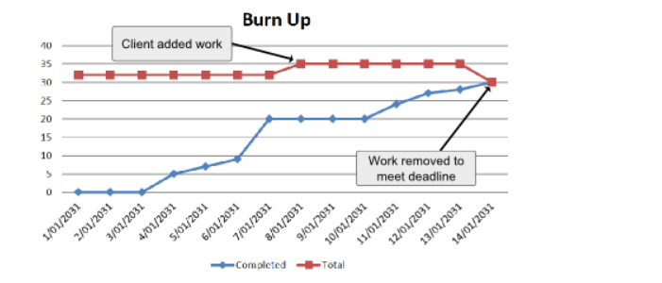
Example of Burnup Chart
The vertical axis is amount of work, and is measured in units customized to your own project. Some common units are number of tasks, estimated hours or story points (in agile project management methodologies).
The horizontal axis is time, usually measured in days.

Slide 34
Burndown vs Burnup Charts
A burnup chart shows both completed work and total project scope, making it easier to track scope changes
A burndown chart, however, focuses solely on the remaining work, providing a clear view of what’s left to do.
Burnup charts offer a more comprehensive view, while burndown charts are simpler and more focused.
Burnup charts are ideal for projects where scope changes frequently. Burndown charts shine in projects with a fixed scope.

Slide 35
SPRINT REVIEW
When: Held at the end of the Sprint.
Who: Scrum Team + Stakeholders.
Purpose: To inspect the increment and adapt the Product Backlog if needed.
Activities:
  Present the completed work (increment).
  Discuss what went well and what did not.
  Collect feedback from stakeholders.
  Update the Product Backlog collaboratively.
Key Benefit: Align stakeholders and adapt the product to changing requirements.

Slide 36
SPRINT RETROSPECTIVE
When: Conducted after the Sprint Review and before the next Sprint Planning.
Who: Scrum Team only.
Purpose: To reflect on the process and identify improvements.
Focus Areas:
  What went well?
  What could be improved?
  What will we commit to change in the next sprint?
Outcome: Actionable improvement items to enhance team performance.
Key Benefit: Continuous improvement and stronger team dynamics

Slide 37


